Slide 1
DeepReader
Eric Lawson, Madison Wheeler, Shoshana Malfatto, Birchell Eversole

Slide 2
Recap
DeepReader is an application that increases comprehension of textbooks by requiring the user to take quality notes as they read
Requires notes to be taken before skipping to next page of textbook
Checks quality of notes based on textbook
Technology Used: C++, QMake, QML, Qt Creator, Poppler Qt5
New tools:
Qt
Poppler
QMake
QML
Notes:
Madison

Slide 3
Goals
Initial Goals:
Integrated PDF viewer and text editor
Prevents skipping ahead in textbook by requiring notes be taken first
Implemented with C++ & Qt
We met our goals and started implementing secondary features
Notes:
Eric

Slide 4
Progress Made
Make a pdf viewer and text editor
Found a way to discern whether notes were acceptable for the passage
Created a counter to let the user know how many more notes they need to take
Created a preliminary search function
Created a preliminary timer
Notes:
Not really a stand-alone executable yet
Maybe divide this up so we can all talk a little bit about what we did individually?
Shoshana (me) - pdf viewer using pdf rendering library, I tested this and Maddie tested some others, Poppler had most documentation, debugging because I can run the program on my machine (other people commented out code, I uncommented it and debugged), also made a lot of starter code, dealt with merge conflicts
Birchell - talk about determining relevant notes
Eric - text editor features, user interface
Maddie - talk about documentation, also talk about timer and secondary features maybe

Slide 5
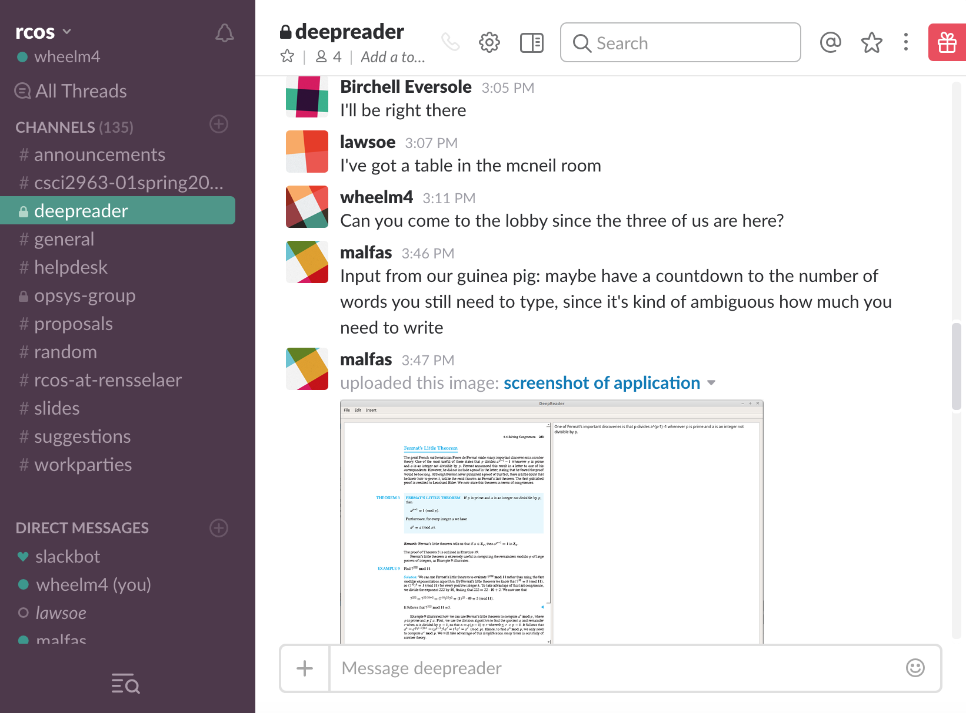
Community Involvement
Team Forum
Slack Channel
Weekly meetings
Observatory Blog
Testers & Feedback
Notes:
Birchell
Tracy: Maybe have a countdown to the number of words you still need to type, since it's kind of ambiguous how much you need to write
Adam:
Matt: It would be nice if the UI looked a bit smoother/cleaner
Lauren: Having some kind of start up screen explaining the application would make it easier to use but looks good otherwise
Jacky: Looks good
Reached out to another classmate (Casey) who was also working with Qt for his project (EGG) even though he never responded

Slide 6
Documentation and Style Guide
Documentation for both users and future developers and the style guide can be found on the github documentation page.
ReadMe
Description of DeepReader
How to run
How to contribute / Contributors
License (GNU General Public License v3.0)
Wiki
Guide for developers (Installation, Guidelines for contributions and Functionality overview)
Guide for users (Installation, How to use the application)
Style Guide
Notes:
Madison - ReadMe, License (Started off with LGPL -> now GNU, images were creative commons, why we chose the license)
Birchell - Wiki
Eric - Style Guide

Slide 7
The Future of DeepReader
Support for other Operating Systems (MacOS & Windows)
Create a stand alone executable
Features for future contributors to work on:
Line spacing and other formatting features such as bullets
Chapter question viewer
Chapter question answer checker
Timer display
Notes:
Madison

Slide 8
Demo
Notes:
Shoshana

Slide 9
Questions?

